Slide 1

Ruby on Rails

Slide 2
About today…
Ruby on Rails
Build form
Handle form data

Slide 4

Define Actions in the Controller

Slide 5
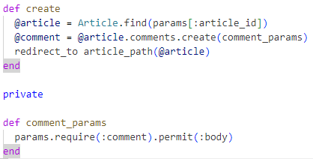
Update Controller
To handle ‘create’ operation
To handle ‘parameters’

Slide 7
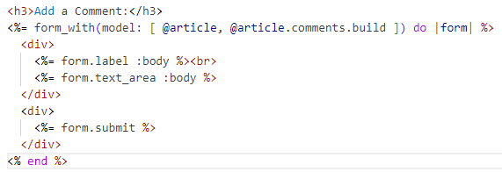
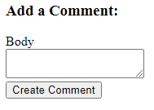
Create the Form View
app/views/comments/index.html.erb

Slide 8
Adding Article

Slide 9
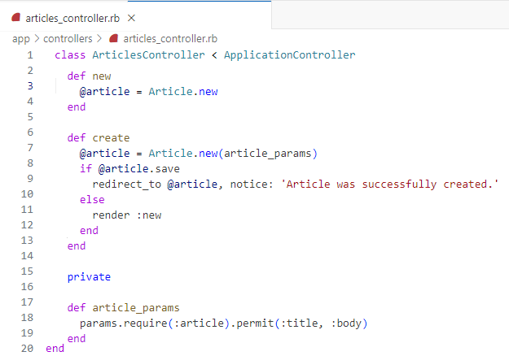
Adjust Controller

Slide 10
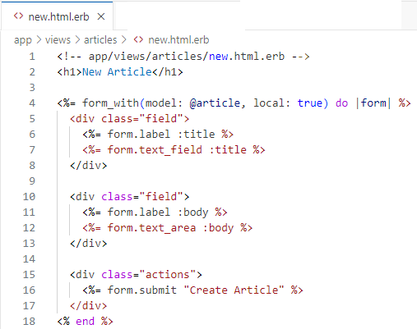
Create View/Form

Slide 11


Slide 12

What method in Rails controllers is commonly used to process form submissions?
Which Rails helper method is used to create a form for a model object that follows RESTful conventions?
How do you specify the HTTP method (GET or POST) when using form_for in Rails?
In Rails, what is the typical convention for handling form submissions in controllers after processing?

Slide 13

Task 1
Create a small program to Insert two data items in the database

